Slide 1

Hiring at the University of Washington and CICOES
August 2026

Slide 2
Welcome
Introductions
Agenda overview

Slide 3
Agenda
Definitions
Choose the right type of position (temporary vs permanent)
Choose the right job title
Write the job description
Fill out the paperwork
Position and requisition approval processes
Reviewing applications in the Workday Workbench
Interview process (including reference checks)
Extending an offer

Slide 4
Definitions
Hiring Manager
  Manages the hiring process for the position
  Does not have to be the Supervisor once the position is filled
NOAA Sponsor
  NOAA Federal group lead or other federal employee who represents NOAA’s interests in the hire
  Can help write the job description
  Does not view resumes or serve on the hiring committee
Hiring Committee
  Committee created to recruit through screening, interviewing, and making the recommendation of the finalist for the position.
  Must be at least 50% UW employees and led by Hiring Manager
  Can’t have NOAA federal employees on committee
Notes:
Reminder that the UW Supervisor can’t supervise for a position at a higher grade than what they are

Slide 5
What type of position do you need?
Temp
Temporary Positions can be Hourly or Salaried
  Deciding what is best depends on if they have a “regular work schedule”
  Positions initially can’t be more than 12 months.
  Can likely be extended for another 12 months after appointment end date.
Generally, we recommend
  Fewer than 6 months and/or fewer than 20 hours per week: hourly temp
  Between 6-12 months and at least 20 regular scheduled hours per week: salaried temp
Temp Positions must be modeled after existing UW job profiles
  Min Requirements for those positions should be met and reflected in candidate resumes
Notes:
Benefits dependent on eligibility. We can discuss on a case by case basis.
Positions are created based on certain guidelines. We can’t say “we are not sure if we want a RSE3 or RSE4, lets create a position for both”. Can’t do that.
Has to follow rules for that position.
Pro Staff Temp positions are not union represented
Generally can’t sponsor visas for temp employees

Slide 6
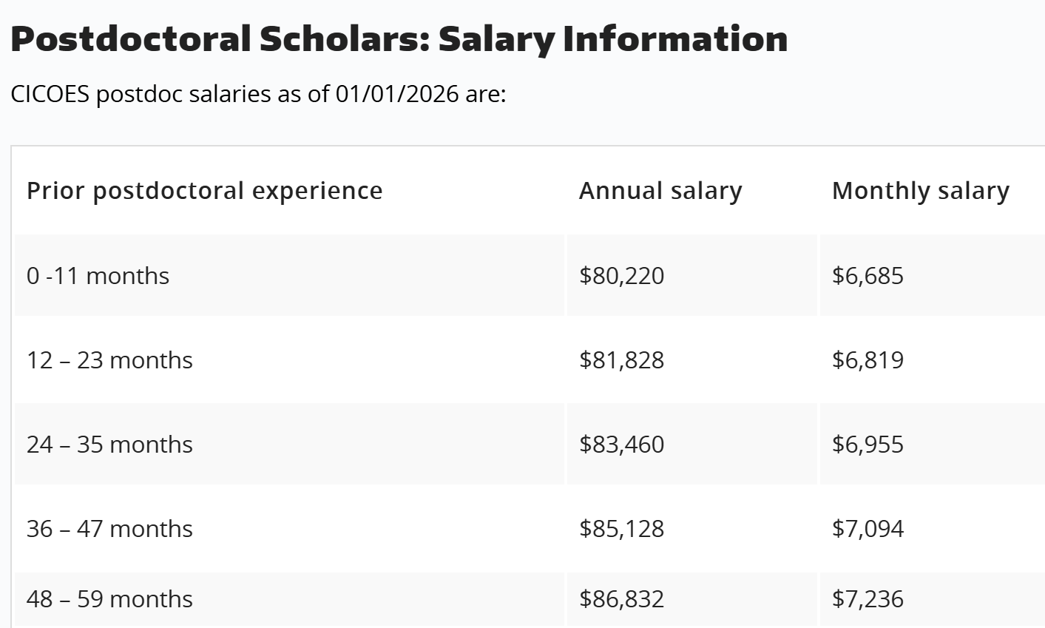
What type of position do you need?
Postdocs
Postdoc Positions
  Must be at least 1-year appointments
  Salary is dependent on prior Postdoc experience
  Limited to 5 years/60 months
  Postdoc Hiring Request Form
  Academic Unit/Mentor
  CICOES can sponsor Visa
Notes:
Postdoc Hiring Request form is different than the Staff hiring Form
CICOES is not an academic unit, so we need one listed
The Academic Mentor needs to be a tenure or tenure-track faculty member
Position can be competitive or not

Slide 7
Direct Hires vs. Competitive Positions
Temp Positions can be direct hires or competitive
  If you have an individual in mind for a position, ensure they meet the minimum requirements and provide the following
    Full Name
    If they are a former UW employee
    Their email address (They will be emailed the link to apply)
    Reason for temporary position (usually it is a project of short term nature)
    Position Duration
    Proposed hours per week
    Proposed Pay (must still fall within job profile range)
Permanent Positions *must be* competitive
  But we can limit the candidate pool to UW employees
  Permanent Positions represented by the RSE Union are subject to the re-hire list
Notes:
Most temporary positions are Professional Staff but we do have a few employees in classified titles- they do administrative or less independent work
For temporary positions, you can have someone in mind and they apply directly to the position, no one else will apply to the position
Permanent positions you must post.
Re-Hire List:
Per the University’s collective bargaining agreement with the United Auto Workers (UAW), an RSE who is subject to layoff may request to be placed on the rehire list for their job profile for twelve (12) months. The University offers funded vacant positions to rehire list candidates in seniority order if the candidate is qualified and possesses the relevant specialized skills, knowledge and demonstrated abilities as determined by the employer.
To determine whether an employee on the rehire list is qualified for a vacant position, Campus Recruitment evaluates their resume against the minimum requirements and additional requirements provided in the job description. We strongly encourage hiring departments to define relevant degree fields and experience for RSEs when positions are created or reviewed and to require relevant degree(s) and experience in the job postings.
All recruitments for UAW-represented RSE positions will be evaluated for potential rehire list placement, including those where the competitive recruitment would be limited to UW employees only.
Rehire list placements are rights provided for in the collective bargaining agreement and are non-competitive. Candidates and hiring departments participate in informational meetings to support the candidate’s decision-making and to provide hiring departments with an opportunity to communicate performance expectations and working conditions. These meetings are not job interviews, as candidates have the right to accept or decline opportunities for which they are qualified. Hiring departments do not conduct reference checks on rehire candidates.

Slide 8
Which job title best fits the position?
Research Scientist/Engineer (1, 2, 3, 4, Senior) are the most common job titles at CICOES
  RSE Assistant through 4 are considered “represented staff” and are represented by the UAW RSE union
  RSE Senior, Principal, and Senior Principal are considered “professional staff”
Other options in the Research category include Research Consultant (more focused on data management) and Research Coordinator
Use the RSE Career Path Guideline PDF document for guidance on which RSE position aligns with your hiring needs
Notes:
You might find that a different job title is more appropriate
Research Consultants and Coordinators are also represented by the UAW RSE union

Slide 9
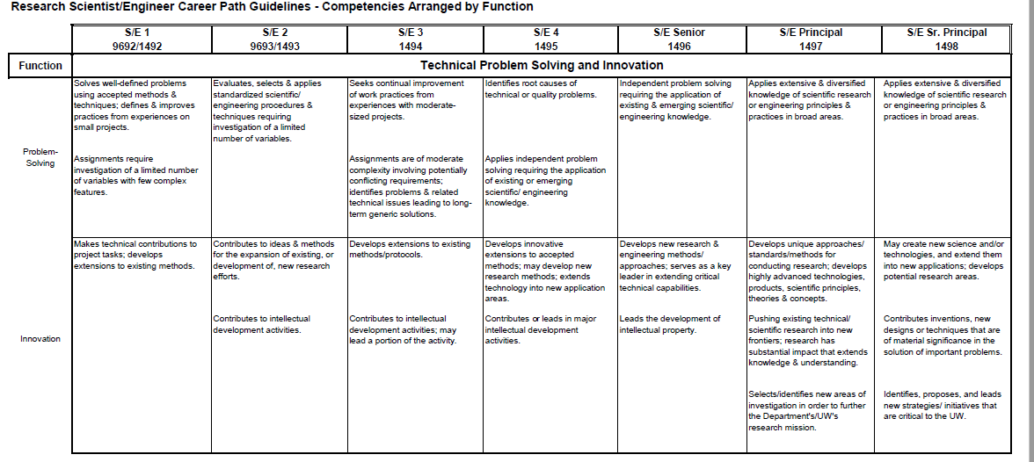
Which job title best fits the position?

Slide 10
Funding Questions
Before a position is created the funding questions must be approved by the Dean’s Office.
Once you have decided the job profile please answer the following questions and send to HR Manager
Postdoctoral and Staff Hires
(Including Research Scientists/Engineers, Research Consultants, and Research Coordinators — for both new hires and extensions)
  For new positions, what is the job profile?
  Is this a permanent/temporary/fixed-term position?
  What is the funding source for the position? Please be specific. i.e., AWD/Grant # or Worktags?
  If externally funded, what is the projected duration of the current funding?
  If the current funding plan falls through, what resources will you/your unit be using to cover an employee’s salary and benefits until such time as the position can be terminated?
  If this is a professional or research staff (RSE/RCoCo) hire, what is the proposed salary range?
Once approved, we can move forward with creating the position.
Notes:
Temporary ex: Temp employee modeled after RSE1
Fixed-term ex: Postdocs
Externally Funded- all grants are externally funded
This is the time to let us know if you want to hire more than 1 position from the funding questions, this can’t be done later

Slide 11
Writing a strong job description
Start with a description of what the team works on and how this position will fit with the team
NOAA can provide input for job attributes and duties
List specific duties
  All duties must add up to 100%
  All duties must be at least 5% and listed as whole numbers
  Can’t be a range
Required qualifications vs desired
  Other represented staff must use the union mandates minimums
  Positions must describe what “relevant experience” means
Notes:
Think about what the true minimum would be
Your rubric should be based on these qualifications

Slide 12
Business Title/Job Profile
Business Title vs. Working Title
  Business Title example: Research Scientist 2
  Working Title example: Mooring Technician
Notes:
Working title helps attract candidates
Helps us distinguish between multiple positions we are working on

Slide 13
VISA Eligibility
Staff Positions may be eligible for H1-B Sponsorship
  Please let Carol/David know if you would like the position to be eligible and they can start the process
  Must be done before position is created
Postdocs continue to be visa eligible
Processing times for H-1Bs and E-3s can vary widely from 2-3 months to 7 months or longer (depending on case type and whether units choose to pay for USCIS premium processing). Processing time can also vary based on the candidate’s current visa status and whether they are located inside or outside the U.S.
Notes:
INSERT J-2 POLICY HERE

Slide 14
Salary Range
Competitive positions must have a monthly salary range listed in the job posting
Salary range that will be evaluated to job classifications and equity
  Carol/David will check internal equity at CICOES
Notes:
We cannot exceed the salary listed in the job postings

Slide 15
Paperwork!
For every position: CICOES Hiring Request Form
For Professional Staff Positions: Professional Staff Position Description (PSPD) form
For Direct Hire Temp Positions: Professional Staff Temporary Position (PSTP) Supplemental Questionnaire
  This form is filled out by Carol/David
  Ensure the individual’s name is spelled correctly and that their email is correct
Notes:
Carol/David fill out the PSTP form

Slide 16
Approval Process: Position Creation
Position: David/Carol→ Fred → Dean’s Office → Compensation → Employee Workday Help
Positions can take up to 6 weeks to complete
Once the position is approved, the supervisor will receive a notification in Workday
  The supervisor can view the position in Workday under their “team”
Notes:
Position creation: David or Carol creates a new position in Workday, unless the recruitment is for a vacant position that already exists
Approved by: Fred, the Dean’s Office, Compensation
Can be sent back at any point with questions as to the appropriate title or job description
Once fixed, it is sent back to the beginning
Carol and David can look at status of positions

Slide 17
Approval Process: Position Requisition
Requisition: Carol → Fred → Dean’s office → Recruitment partner
Needed for the requisition
  How long you want the position posted for
    We recommend 2 weeks
  If you want to require a cover letter (strong business justification is needed for this)
  If Direct Hire- their email is needed (must match UW jobs profile)
>Posting must follow the Job Posting Components
  “About this Opportunity” “Working Conditions” etc
  This is now included in the new hiring request form
Notes:
Requisition creation: HR Manager creates a job requisition in Workday
Includes information such as how long to post the job for
Approved by: the Dean’s Office, the Recruitment Partner
Less likely to be sent back- usually takes under a week
Requisition transferred to Workday Workbench and posted
Can be held in “HR Review” for a few days
Requisition is the point when it can be posted and become publicly available

Slide 18
Approval Process: Position Requisition
Once Requisition is approved, the Recruiter generates a posting preview
  It is sent to the hiring manager for review. Once reviewed, it is posted to Workday and can be widely shared.
Notes:
Requisition creation: HR Manager creates a job requisition in Workday
Includes information such as how long to post the job for
Approved by: the Dean’s Office, the Recruitment Partner
Less likely to be sent back- usually takes under a week
Requisition transferred to Workday Workbench and posted
Can be held in “HR Review” for a few days
Requisition is the point when it can be posted and become publicly available

Slide 19
Advertising
Workday posts the position to various sites; including Glassdoor, Indeed
The hiring manager can share the posting with their network.
CICOES can cover the cost of a posting to the Society for Advancement of Chicanos/Hispanics & Native Americans in Science (SACNAS).
Competitive positions can be posted to the CICOES LinkedIn page and to UW Affinity Group Listservs.
Notes:
Hiring Managers can share with their own networks

Slide 20
Applying to Requisitions
From a best practice standpoint, we encourage candidates to plan ahead and submit their applications before the final day whenever possible, as this helps avoid any last-minute issues.
Job listings do include a built-in countdown feature. Initially, this is displayed in days and then transitions to hours as the closing time approaches. This provides applicants with a clear view of how much time remains to apply.
Notes:
Hiring Managers can share with their own networks

Slide 21
Applying to Requisitions
Regarding timing, the Workday system is configured to close postings at approximately 12:01 a.m. on the listed closing date. For example, a posting open from 5/18 through 5/26 will close just after midnight at the start of 5/26. I completely understand how this can feel confusing, especially since the previous UW Hires system allowed postings to remain open through the end of the listed day. Unfortunately, this timing is system-driven, and we don’t have the ability to adjust it.
Notes:
Hiring Managers can share with their own networks

Slide 22
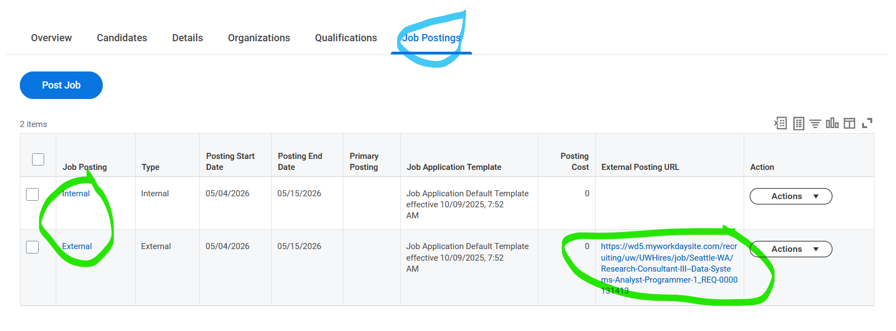
Internal vs. External Applicants
On the hiring request form you can select if you want only current UW employees to apply to the position.
Internal and external candidates have different links to apply to a job requisition
The Internal is a Workday internal link that employees can only access and need to apply to by being logged into their employee workday account.
The link for external candidates can be found in the Workbench
Notes:
Hiring Managers can share with their own networks

Slide 23
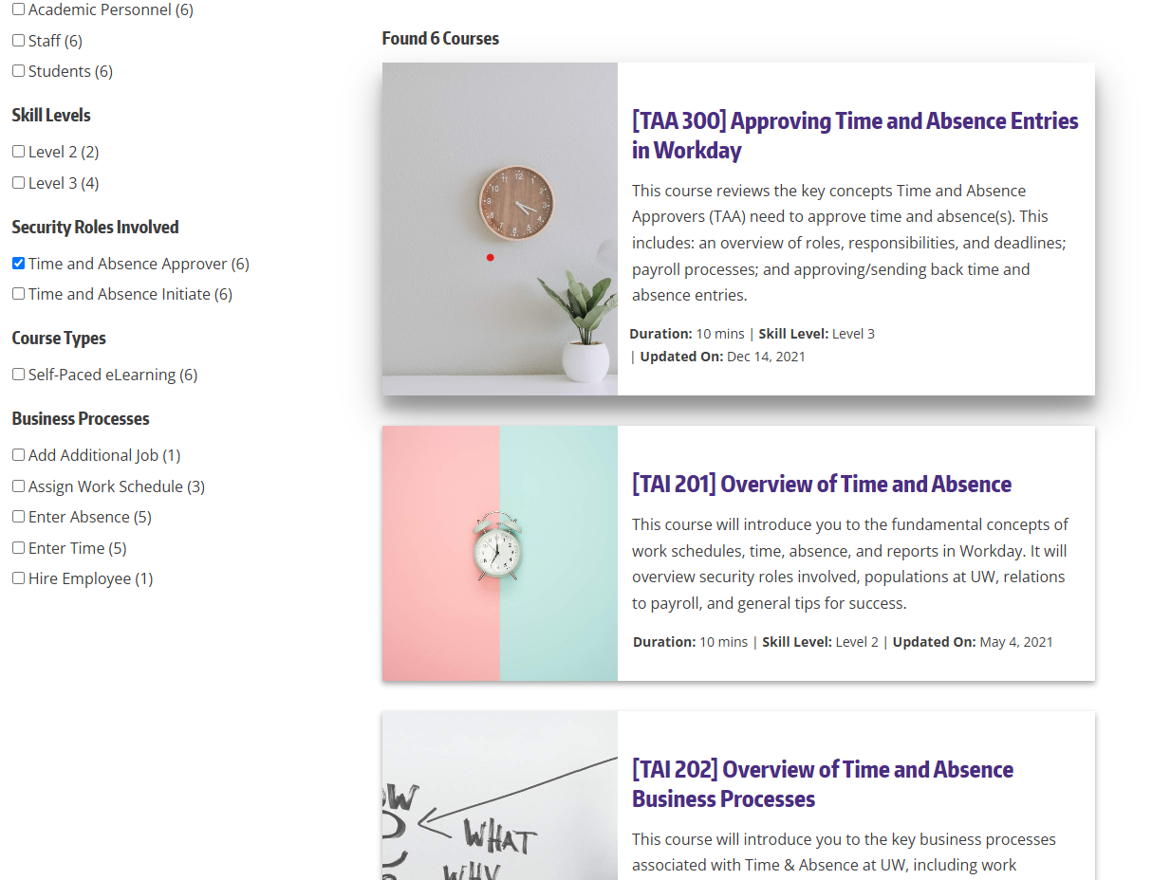
Hiring Manager Training
Required Training:
  Implicit Bias
UW Supervisor Training
  Professional Organizational Development Supervisor Training
  Time and Absence Approver (see screengrab)
  CICOES Supervisor Responsibilities
Notes:
The hiring manager is the only person on the committee required to take these trainings, but we recommend all UW individuals on the committee take the training
Please save a record of you completing the training or send to Carol/Sharae so we can save it in your personnel file
Add hyperlinks to trainings
No Time Initator training, just time approver

Slide 24
Hiring Committee
Decide who will be on your hiring committee
NOAA Federal employees are not allowed to be on hiring committees, all others can participate.
Hiring Committee must be at least 50% UW
  There should be at least 2 people on the committee
Create the rubric you will use to score resumes (based on job qualifications)
Each committee member should individually score the resumes

Slide 25
Hiring Committee Recommendation
Once members of the Selection Committee are chosen, the Hiring Manager and HR Manager will identify a schedule for each of the items below (items can vary). Each of the meetings (or e-mail conversations) below should include the Hiring Manager and Selection Committee:
  An initial, introductory meeting to review the hiring process, equitable hiring information; discuss goals for the position, begin reviewing the job description and rubric, and review anti-bias training materials
  Meeting to finalize job description and rubric. The job is usually posted for 1 to 4 weeks as well as “opened until filled”. The date can also be extended to a later date.
  Meeting to discuss written application materials (resume, cover letter, writing samples, etc.) and select candidates for virtual or in person interviews. (Recommended time: 1-2 weeks for review of written materials for a typical one person recruitment)
  Meeting to discuss/finalize interview questions
  Time block for first-round interviews (1-2 weeks)
  Meeting to select candidates for second round interviews and finalize interview questions
  Time block for second-round interviews (1-2 weeks)
  Meeting to discuss final candidates and make recommendation of finalist(s)
  Submit hiring notes to HR Manager
Notes:
Guide

Slide 26
Workday Workbench
Platform to view and disposition application materials (resume and cover letter)
  Not all applicants submit attached resumes to their applications, and they are not required to by the system. Some will just fill out the application portion of the workday profile, which you see on the candidate’s ‘summary’ page of their profile when clicking into them.
Applications are “pushed” to the workbench by our recruitment partner

Slide 27
Workday Workbench
Candidates are released in batches of 50
  Referrals after the second batch are contingent upon you dispositioning candidates who are no longer under consideration, then letting me know you’d like an additional batch for consideration.
  *Dispositioning*
    All candidates must be screened and dispositioned by the hiring manager
    Group A- candidates you’d like to interview
    Group B- candidates people they would consider or interview.
    Group C- candidates you may interview
    If they are people they would not consider further, they should be declined. The spirit of dispositioning is to ensure we are letting candidates know where they stand in the recruitment in a timely manner. If someone isn’t going to be considered further, then they shouldn’t have to wait to find that out.
  When screening requisitions with 50 or more applicants, the team will first review bargaining unit employees (for contract classified positions), then applicants covered by veterans’ preference, and then current UW employees (for all job types). The remaining applicants will be sorted alphabetically, and we will screen every Xth one, where X is determined by the total number of applicants. (So, the distribution is random as best possible)

Slide 28
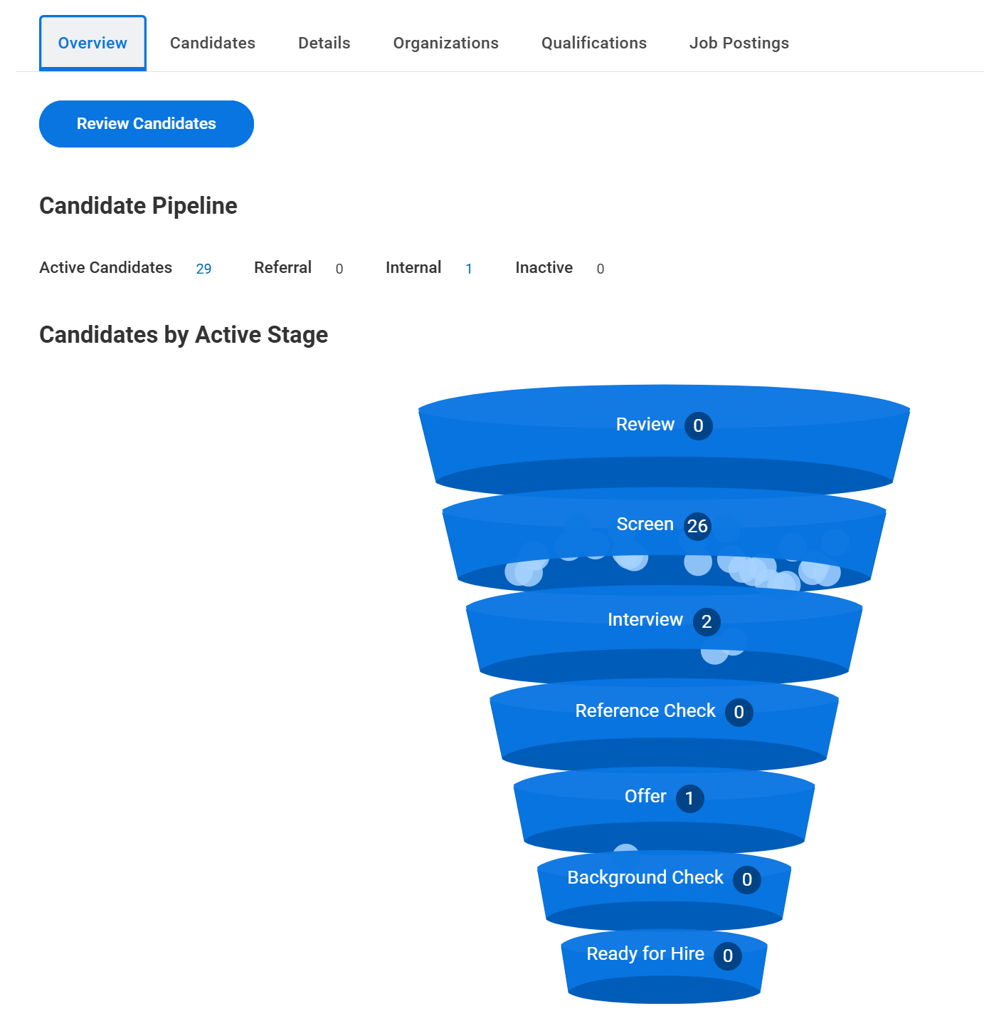
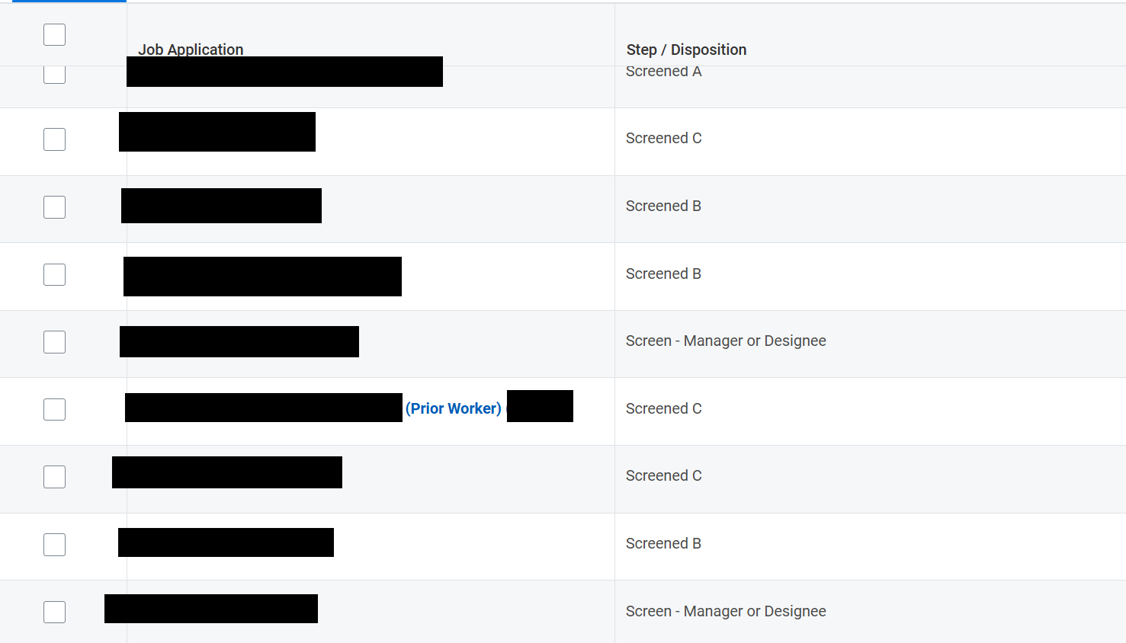
Notes:
Click the candidate’s name to view their resume.
Click the percentage sign to view their cover letter and other information
Best to disposition candidates as you go

Slide 29
The Interview Process
Prior to the first “round” should be a telephone screen
Ask all candidates the same questions in the same format (virtual/in-person)
Here are some interview tips and fair and unfair questions
Do not ask about current or past salary
Resources: behavioral interview questions
Notes:
Consider using “behavioral interviewing” ie questions in the format of “tell me about a time when…” There are examples on the interview tips page
If some candidates must have a virtual interview, all candidates should have the option of a virtual interview
The salary you offer must be based on the work that will be done in the position and the qualifications the person is bringing
For Tours at PMEL- interviews are held first, then a follow-up tour can happen. Anyone interested in a tour should connect with Diane at PMEL.

Slide 30
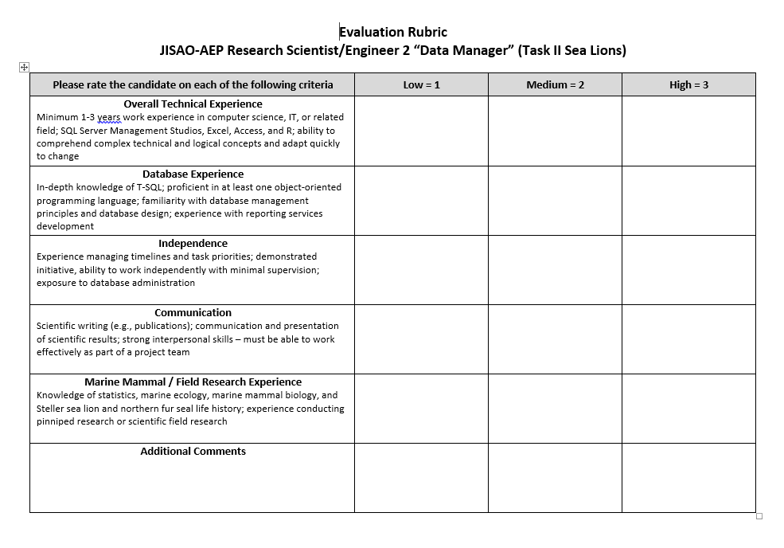
Notes:
This is an example rubric

Slide 31
Reference checks
We highly recommend you complete reference checks for at least your top candidate
This should happen before the conditional offer is made
Reference check resources
*If the candidate is a current or past UW employee you must obtain a reference from their current or most recent supervisor, and you can also request their personnel file*
Notes:
You can complete reference checks for other candidates if you think they will help you make a decision
Reference checks are ideally completed over the phone
The reference from the current supervisor can, if needed, come after the conditional offer but must come before the final offer

Slide 32
Extending an offer
Once you have your top candidate:
Contact Carol with the salary and start date you would like to propose
Make a conditional verbal offer to the candidate that should include, start date, salary, and moving allowance if applicable
Negotiations may ensue but salary can’t exceed posted salary range
Once you and the candidate have agreed on a salary and start date, tell Carol and she will get approval through UWHires
Carol will send an official offer letter to the candidate
Notes:
A moving bonus is a lump sum payment typically in the $2000-$4000 that can be offered to permanent employees if they are moving to the Seattle area. It is paid from your grant, not centrally and the amount is subject to taxes, so if you would like your candidate to end up with $2000 in their pocket, offer an amount higher than that.
Amount can not be “grossed up”
We recommend conditional offers be made via phone or virtual meeting

Slide 33
A note on start dates
Health insurance coverage begins on the first day of the month
An employee must start on the first business day of the month, otherwise their health insurance coverage will not start until the first day of the next month
Notes:
Please remember this! Some employees may not ask and just assume that their health insurance will start on their first day.
Even though they will not select their health insurance plan until later in the month, if they started on the first business day their coverage will be retroactive to that day

Slide 34
Offer acceptance
Candidate must sign and return the offer letter
Carol then initiates the hire process in Workday
END hiring process, BEGIN onboarding process!
  Begin working on their CAC, connect with the NOAA sponsor on your team and/or Nancy Curl
  Necessary trainings (UW and NOAA)
  Figure out office space
  Onboarding Buddies
  I-9 form
Notes:
You did it!
Carol will send the supervisor the offer letter for review before it goes to the candidate
Begin working on their CAC, connect with the NOAA sponsor on your team and/or Nancy Curl
Necessary trainings (UW and NOAA)
Figure out office space
Onboarding Buddies

Slide 35
Things to remember
This is a long process (2-4 months overall for competitive positions)
Keep all records
The admin team is here to help with things like job descriptions, choosing the right position/level/salary
Notes:
Consider setting a timeline when you begin to keep things on track
Records related to the recruitment process must be retained for three years (this includes notes on interviews and reference checks)
UW undergrad students can be hired and it is a much shorter process
Processes may have changed since the last time you did it, please be connect with Carol/Sharae if you have any questions

Slide 36
A few additional resources
UW Hiring Process
Professional Staff Temporary Positions

